Slide 1



HR Diversity & Inclusion
View in Power BI
Last data refresh:
21/05/2023 12:31:58 UTC
Downloaded at:
21/05/2023 12:35:20 UTC

Slide 2
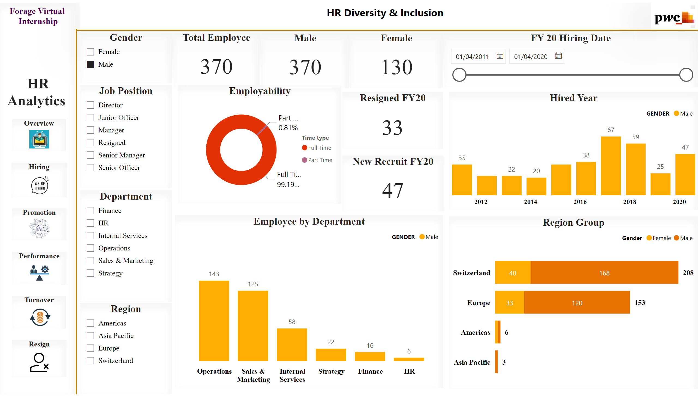
Overview
Notes:
image
No alt text provided
textbox
No alt text provided
Overview
No alt text provided
Hiring
No alt text provided
Promotion
No alt text provided
Performance
No alt text provided
Turnover
No alt text provided
textbox
No alt text provided
Gender
No alt text provided
Department
No alt text provided
Job Position
No alt text provided
Region
No alt text provided
Total Employee
No alt text provided
Employability
No alt text provided
Employee by Department
No alt text provided
Region Group
No alt text provided
Hired Year
No alt text provided
Resigned FY20
No alt text provided
New Recruit FY20
No alt text provided
Male
No alt text provided
Female
No alt text provided
shape
No alt text provided
shape
No alt text provided
Resign
No alt text provided
FY 20 Hiring Date
No alt text provided

Slide 3
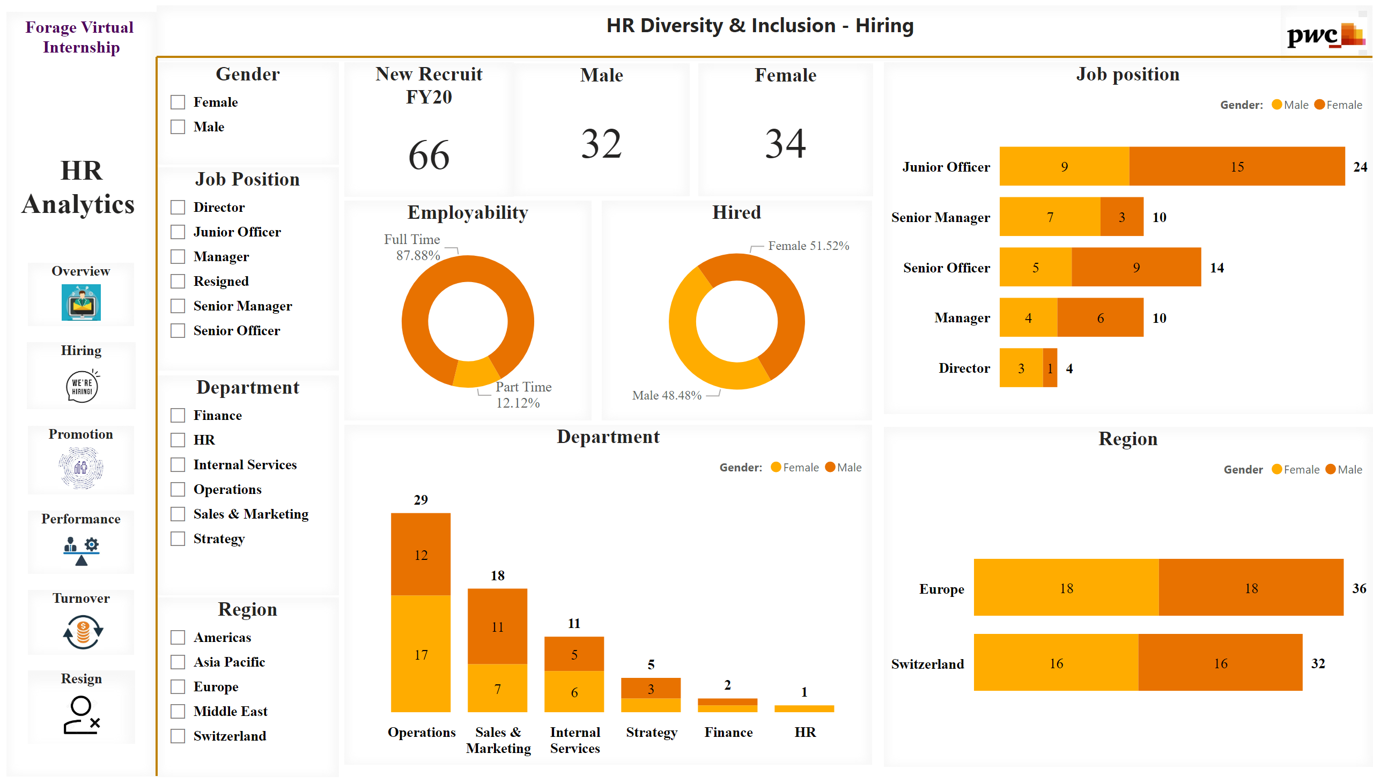
Hiring
Notes:
image
No alt text provided
textbox
No alt text provided
Employability
No alt text provided
Department
No alt text provided
Region
No alt text provided
Job position
No alt text provided
New Recruit FY20
No alt text provided
Male
No alt text provided
Female
No alt text provided
Hired
No alt text provided
shape
No alt text provided
shape
No alt text provided
Overview
No alt text provided
Hiring
No alt text provided
Promotion
No alt text provided
Performance
No alt text provided
Turnover
No alt text provided
Resign
No alt text provided
textbox
No alt text provided
Gender
No alt text provided
Job Position
No alt text provided
Region
No alt text provided
Department
No alt text provided

Slide 4
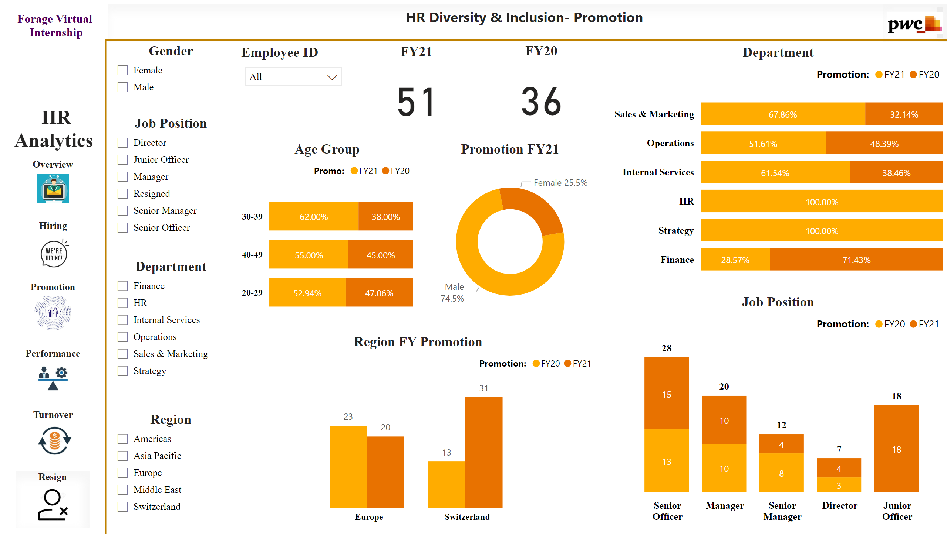
Promotion
Notes:
image
No alt text provided
textbox
No alt text provided
Overview
No alt text provided
Hiring
No alt text provided
Promotion
No alt text provided
Performance
No alt text provided
Turnover
No alt text provided
Resign
No alt text provided
textbox
No alt text provided
Gender
No alt text provided
Department
No alt text provided
Job Position
No alt text provided
Region
No alt text provided
Age Group
No alt text provided
Job Position
No alt text provided
Department
No alt text provided
FY20
No alt text provided
FY21
No alt text provided
Employee ID
No alt text provided
Region FY Promotion
No alt text provided
Promotion FY21
No alt text provided
shape
No alt text provided
shape
No alt text provided

Slide 5
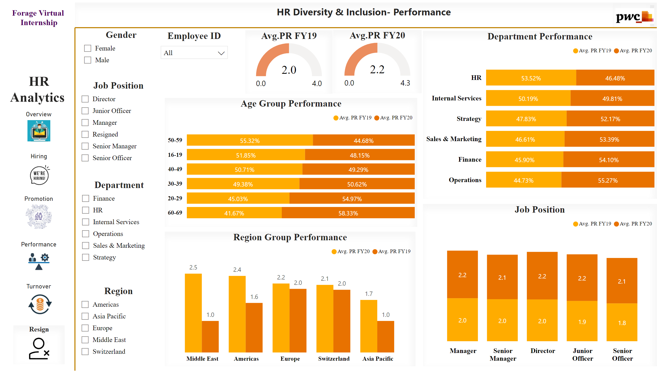
Performance
Notes:
image
No alt text provided
textbox
No alt text provided
Overview
No alt text provided
Hiring
No alt text provided
Promotion
No alt text provided
Performance
No alt text provided
Turnover
No alt text provided
Resign
No alt text provided
textbox
No alt text provided
Gender
No alt text provided
Department
No alt text provided
Age Group Performance
No alt text provided
Job Position
No alt text provided
Department Performance
No alt text provided
Avg.PR FY20
No alt text provided
Avg.PR FY19
No alt text provided
Employee ID
No alt text provided
Region Group Performance
No alt text provided
shape
No alt text provided
shape
No alt text provided
Job Position
No alt text provided
Region
No alt text provided

Slide 6
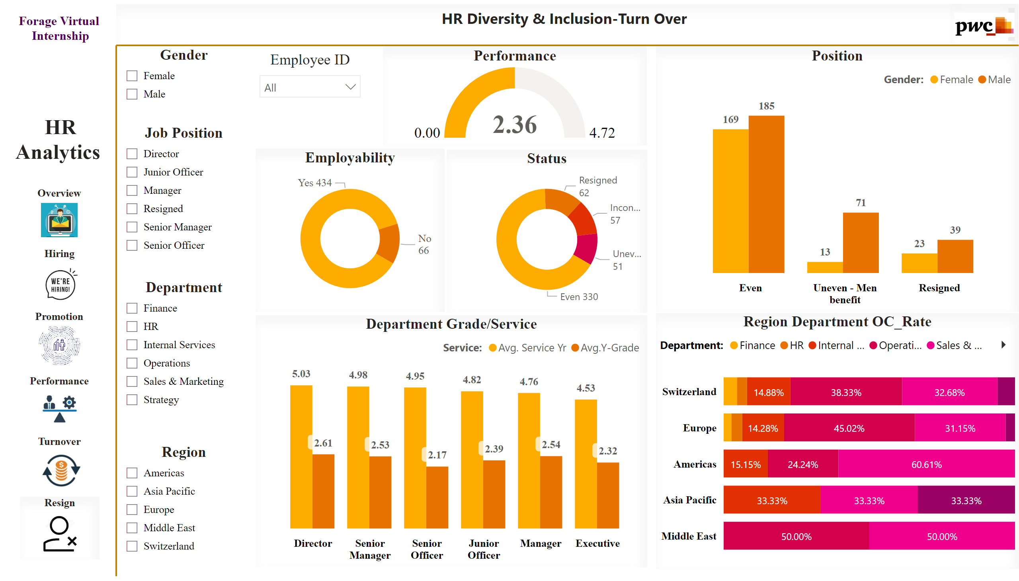
Turn Over
Notes:
image
No alt text provided
textbox
No alt text provided
Overview
No alt text provided
Hiring
No alt text provided
Promotion
No alt text provided
Performance
No alt text provided
Turnover
No alt text provided
Resign
No alt text provided
textbox
No alt text provided
Gender
No alt text provided
Department
No alt text provided
Job Position
No alt text provided
Region
No alt text provided
Employability
No alt text provided
Department Grade/Service
No alt text provided
Region Department OC_Rate
No alt text provided
Performance
No alt text provided
Status
No alt text provided
Position
No alt text provided
shape
No alt text provided
shape
No alt text provided
Employee ID
No alt text provided

Slide 7
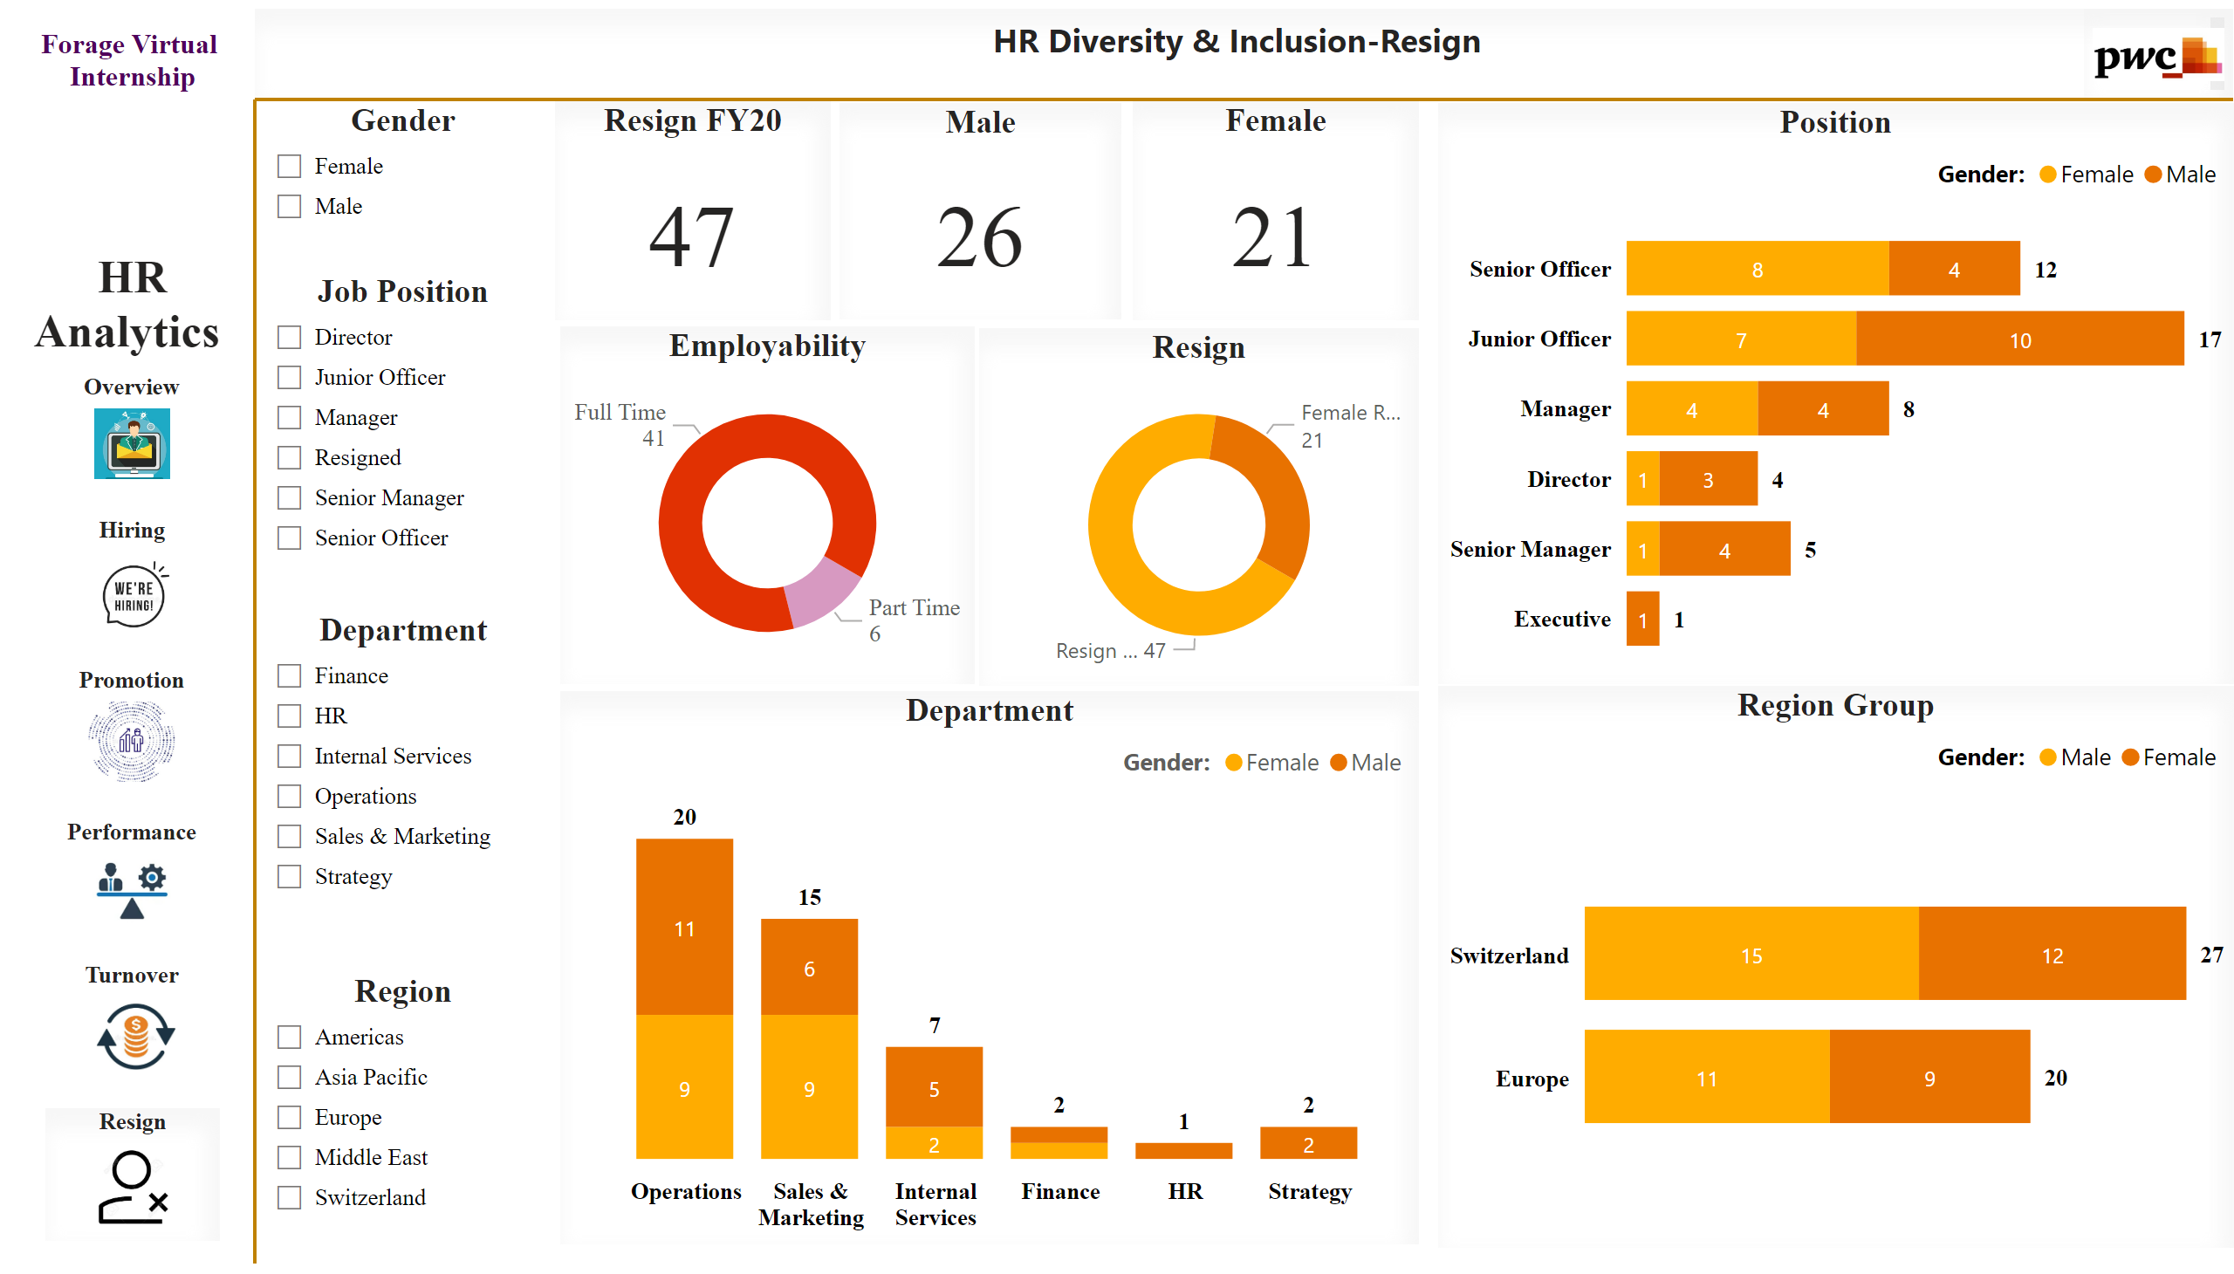
Resign
Notes:
image
No alt text provided
textbox
No alt text provided
textbox
No alt text provided
Employability
No alt text provided
Department
No alt text provided
Region Group
No alt text provided
Resign FY20
No alt text provided
Male
No alt text provided
Female
No alt text provided
Resign
No alt text provided
Position
No alt text provided
shape
No alt text provided
shape
No alt text provided
Resign
No alt text provided
Turnover
No alt text provided
Performance
No alt text provided
Promotion
No alt text provided
Hiring
No alt text provided
Overview
No alt text provided
Gender
No alt text provided
Job Position
No alt text provided
Region
No alt text provided
Department
No alt text provided

